Slide 1
Smart India Hackathon 2017
Ministry Category : Indian Space Research Organisation (ISRO)
Problem Statement : Develop an efficient spear phishing mail detection system
Team Leader Name : Anup Kumar Panwar
Problem Code : #ISR47
Current AICTE Application No. : 1-3328528908
IDEA
Our idea is to develop a SECURE EMAIL SERVICE (both App & Website).
We will provide a more efficient PHISHING MAIL detection solution which will be based on Bayesian anti-spam classifier.
The open source version is available at http://antispam.readthedocs.io/en/latest/
This classifier uses Machine Learning to classify an email as PHISHING EMAIL or not.
We will train our own model with a large dataset of phishing and spamming emails.
Moreover we will customize the code to detect MALWARE not only based on text content of the email but also on the attachments in the emails, with an higher accuracy.
For a email to be classified as safe the sender’s email must also match the registered and undersigned domain.
The links in the email will be checked through GOOGLE SAFE BROWSING APIs (v4).
Also, we will integrate the CLI based system into a working email service with an inbox, outbox and UNSAFE mails.
Technology Stack
Angular.js, jQuery, PHP, MySQL DB, Python, AJAX, PHP Mailer, APACHE server, WAMP/LAMP, Ionic Framework, ng-Cordova, Android Studio, Node.js, HTML, CSS, Material Design Light (MDL), JavaScript

Slide 2
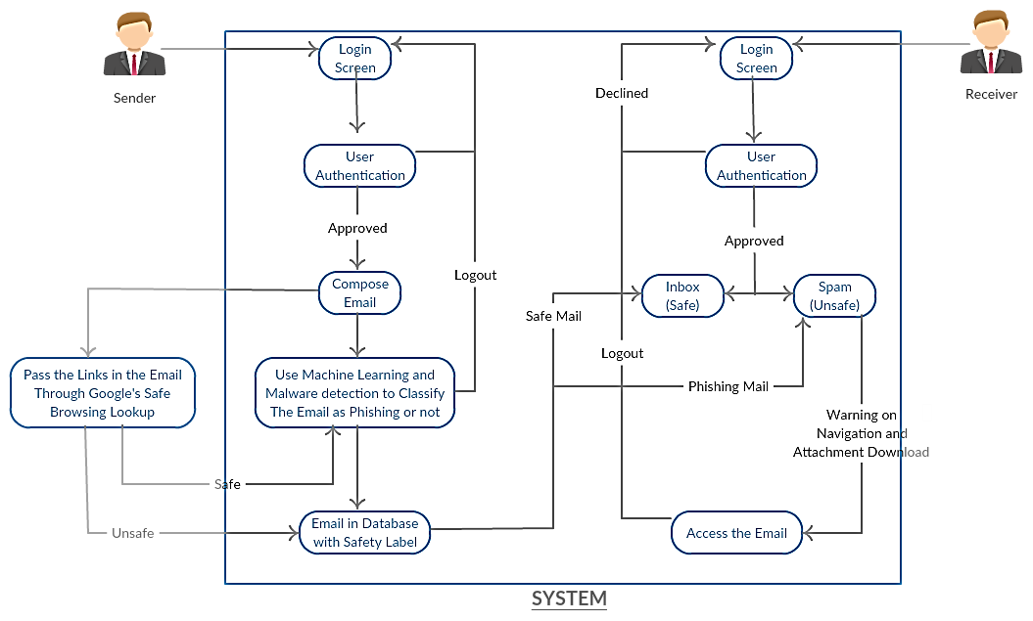
USE CASE
DEPENDENCIES
Android Device, Internet Connection, A computer, Antispam, GOOGLE SAFE BROWSING LOOKUP APIs (v4)

